Slide 2
What’s today about?
Identifying signs of trouble
Reaching out and talking about sensitive topics
Offering emotional and practical support
Identifying what services are available and where to find them
Inspiring YOU to take action!

Slide 3
Do we REALLY need to reach out more?

Slide 4
If you needed to, could you ask someone who does not live with you for this type of support in a time of crisis?
81.5% | Advice on what to do | 68.5% | Help out when you have a serious illness or injury
70.9% | Emotional support | 55.1% | Help in maintaining family or work responsibilities
68.9% | Mind a child for a brief period | 65.6% | Help with moving or lifting objects
62.6% | Borrow tools or equipment | 66.7% | Provide emergency food
Do we REALLY need to reach out more?
Source: 100 Families Project, UWA

Slide 5
You don’t need to be a close friend to make a difference
Do we REALLY need to reach out more?

Slide 6
Where does it hurt when…
We are sad, worried or scared?
We don’t get on with our family, friends, partners or work buddies?
We are worried about money?
Where does it hurt when

Slide 7
Let’s Talk
Listen
Empathise
Acknowledge
Don’t Judge

Slide 8
Your Turn
Let’s Make the Conversation

Slide 9
Let’s start the conversation
I noticed that you haven’t been acting your usual self. Is anything troubling you?
I noticed that…[name specific observation]. Is everything OK?
I wanted to talk because I am worried about you.
If you need someone to listen or talk to, I am here.
Let’s start the conversation

Slide 10
Having the conversation
Ok, I respect that, I just wanted to check in with you.
I’d rather not talk about it.
No, I’m fine mate. I don’t know what you are talking about.
Just know I care about you mate and I don’t want you to feel alone.
It’s none of your business.
Why, what are you going to do?
OK, but I’m here if you ever want to chat.
Having the Conversation

Slide 11
It’s fine, really, no big deal….
I’m not good, actually….
I don’t know what to do…
Do you want to grab a cuppa /go for a walk and we can chat?
I’m here if you want to tell me about it.
LISTEN, NOD, EMPATHISE, ACKNOWLEDGE
I don’t have the answer, but I am here to support you.
This must be difficult to talk about, thanks for trusting me.
That sounds really hard, no wonder you are feeling the way you are.

Slide 12
What if they say they feel suicidal?

Slide 13
DON’T PANIC!
Having feelings of suicide is different to having a plan to do it. If you aren’t sure then ask them.
Request a welfare check if needed.
No secrets - ask who else knows or who they can talk to.
Support them to make an appointment with a GP.
Check out Sane, Lifeline, Beyond Blue for more information
What if they say they feel suicidal?

Slide 14
Confidentiality and sharing information
Respect privacy is important, but safety is priority
Sometimes we need to tell others:
Suicide ideation
Under 18
When you believe they will cause harm to themselves or others.
Impaired capacity to make decisions (eg. dementia or injury).

Slide 15
What helps?

Slide 16
Practical Support
Practical support can look like a lot of things
Consider offering ‘specific’ vs ‘general’ help
Think about short vs long term needs
You don’t need to do it alone
Apps are available to help identify and coordinate support:
Friend in Need
Gather my Crew
Meal train
What Helps

Slide 17
Talking to people and being listened to
Friend
Family
Neighbour
Colleague
Phone help line
Counsellor:
Psychologist
Relationship counsellor
Financial counsellor
Support group
What Helps

Slide 18
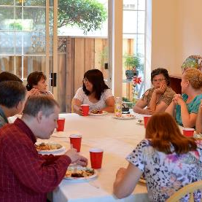
Taking part in the community
Spending time with friends
Joining a club or community centre
Trying a new activity with others
Contributing to community events
What Helps

Slide 19
Looking after yourself
Healthy diet
Limiting drug and alcohol use
Taking time out to do what we want to do (hobbies, spiritual matters)
Exercise
Get a health checkup
What Helps

Slide 20
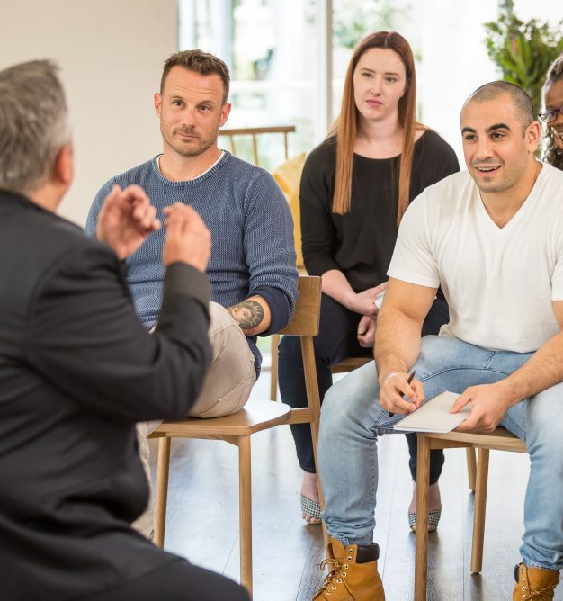
Learning about what works and what doesn’t
Community education classes, eg:
Parenting classes
Financial education classes
Support groups, eg:
Gamblers Anonymous
www.gaaustralia.org.au
What Helps

Slide 21
Learning about what works and what doesn’t
Websites, eg:
mhfa.com.au
for information about mental health
www.relationships.org.au
for information about relationship matters
www.moneysmart.gov.au
for information about managing money and reducing debt
What Helps

Slide 22
Learning about what works and what doesn’t
Help lines, eg:
Beyond Blue (1300 22 4636) for mental health advice
National Debt Help Line (1800 007 007) for information about financial counsellors and managing debt
1800 RESPECT (1800 737 732) for support for sexual assault or family violence
What Helps

Slide 23
Professional Helpers
Start with contacting a help line or a GP
Suggest getting a Mental Health Plan
Shop around
Suggest other professional helpers
Psychologist
Social Worker
Psychiatrist
Counsellor (individual, couples, family)
Mediator
Family Dispute Resolution Practitioner
Family Lawyer
Financial Counsellor
Financial Planner
Financial Advisor
Accountant
What Helps

Slide 24
Where to send them for help
Mental Health
Family & Relationships
Money Talk
In an emergency
000
Call police for welfare check
Call ambulance if believed to be injured
000
Call police if you have safety
concerns
Crisis Care (for child safety issues)
1800 979 777
Emergency Relief and Food Access Service
Need to talk to someone
Lifeline, Beyond Blue, Sane,
MensLine, Headspace
1800RESPECT, MensLine, Kids Helpline, Women’s Domestic Violence Helpline, Elder Abuse Helpline
National Debt Helpline
Face to face Financial Counsellor
Need to get ongoing support
See a GP who can refer to a Practitioner
Or
Skip the GP and link straight to professional support (more costly)
Seek professional support – Counselling services for individual or couples
Attend a workshop to build new skills to improve your relationships
Financial Counselling service (free)
Professional paid support
Talk to your lenders (electricity/gas/bank)
What Helps

Slide 25
Where to find help

Slide 26
WA Connect
waconnect.org.au
Health Direct
healthdirect.gov.au
Ask Izzy
askizzy.org.au
Connect Groups
connectgroups.org.au
Where to find help

Slide 27
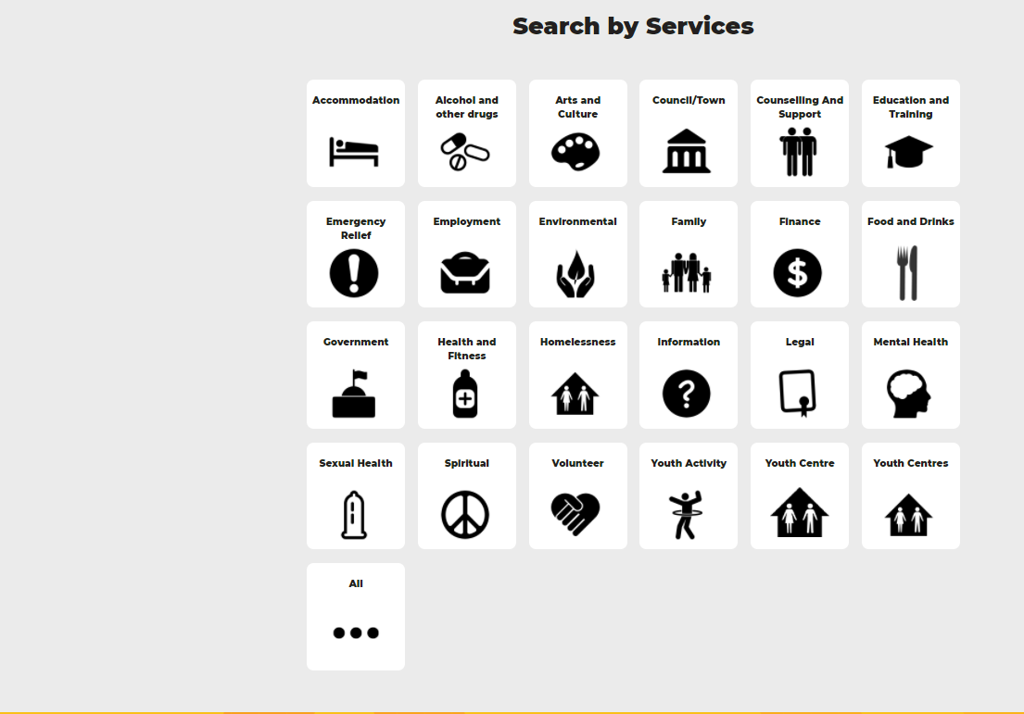
Youth Services Directory
yacwa.org.au/ways/
Where to find help

Slide 28
Your Turn
Find some answers – case study scenarios!

Slide 29
Not long ago, Ana confided that she’s anxious about her finances and that she was getting into substantial debt. Yesterday, you found out from another friend that Ana has just lost her job.
You know that Ana has a couple of mates who can help her with job advice and CVs, but you want to offer additional support.
Xavier has recently lost his partner and is struggling with loneliness. Hanging out with his regular social group seems to bring back painful memories, and he is constantly feeling like a third wheel. Your last conversation led you to believe that he is becoming quite depressed and doesn’t seem to know what options are available to him.
You resolve to continue to be there for Xavier, but you wonder if there is more that you can do than just keep on inviting him for dinner and catching up for a beer. You are seeing Xavier again shortly and want to offer more help.
Explore the Money Smart and Financial Counselling websites to find out what information these sites contain so that you can tell Ana about them.
Find a Financial Counsellor in your local area.
Find at least one other service that might help Ana financially – e.g. food assistance.
Find a website which provides a list of clubs or social events in your area and identify at least one that you would be willing to accompany Xavier to if he wanted to try some new activities.
Identify and find two professional services that you think might offer useful support to Xavier.
Find the contact details for a grief support group that Xavier might want to consider joining.
Ask Izzy
askizzy.org.au
WA Connect
waconnect.org.au
Connect Groups
connectgroups.org.au
Health Direct
healthdirect.gov.au
Youth Services Directory
yacwa.org.au/ways/

Slide 30
Impact on children
Mental health issues, family relationship problems or financial stress in parents may result in:
reduced emotional availability
change perception of the child
impaired ability to support child development
reduced participation in the community
Impact on children

Slide 31
Impact on children (cont)
Health and development
Sleeping and eating regulation
Attachment and relationships
Socialization and behaviour
Identity and self awareness
Education and learning
Impact on children

Slide 32
If you remember only five things
If things don’t seem right – they probably aren’t. Dig deeper.
Listening and empathy go a long way.
Look for ways to connect, empower and educate.
There is lots of help! Start your search with WA Connect or Ask Izzy.
BE THE ONE WHO MAKES THE DIFFERENCE

Slide 33
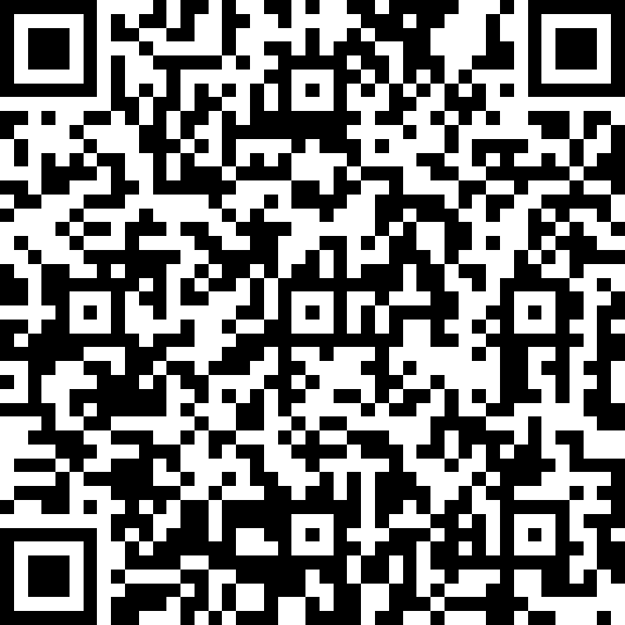
Friend in Need is proudly developed by Anglicare WA.
Let us know what you think!
friendinneedwa
friendinneed
Get in touch:
friendinneed@anglicarewa.org.au
www.friendinneed.org.au

Slide 34
Interested in expanding your knowledge?
Interested in expanding your Knowledge?
Anglicare WA offers a range of educational workshops for different interest groups.​
If you want are interested in a workshop for yourself, your workplace, community group or school then visit our website at www.anglicarewa.org.au to find out more.​
Call us on 1300 11 44 46​ or e-mail: info@anglicarewa.org.au
Relationship Education​
We offer workshops to support you with: Couples relationships, Communication, Family relationships (including parenting support), Emotions and thoughts and Family and domestic violence.
Sessions can be customized to meet your needs. ​
We also work in partnership to deliver Parenting Connection WA with Ngala, Anglicare and Wanslea which provides free locally relevant workshops and information for parents and carers.​
Community Education
School based workshops
“It Only Takes One” empowers students with the knowledge and advocacy skills to be changemakers in their communities.​
Community based workshops “Friend In Need” is a community capacity building workshop targeted at building knowledge and confidence to support people in times of need and understand what services are available and how to connect with them.​
​
Workplace Education ​
We offer a range of workshops aimed at building the skills and knowledge of your employees. ​
Community services – Intro to Family and Domestic Violence, Workshops for enhancing clinical practice,
General workplace development - Accidental Counsellor, Person Centred De-Escalation
White Ribbon accredited Family & Domestic Violence Workplace training​

