Slide 2
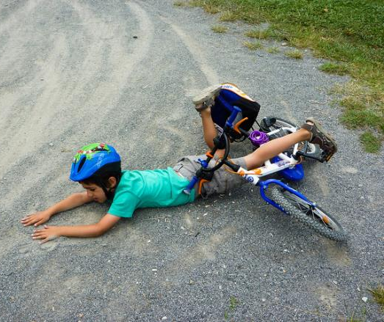
Where does it hurt?

Slide 3
Where does it hurt when…
We are sad, worried or scared?
We don’t get on with our partners or family?
We don’t have enough money?
Where does it hurt when

Slide 4
What helps?

Slide 5
Let’s Talk
Listen
Empathise
Acknowledge
Don’t Judge
I noticed you haven’t been yourself lately. Is everything OK?

Slide 6
Talking to people and being listened to
Friend
Family
Neighbour
Colleague
Phone help line
Psychologist
Relationship counsellor
Financial counsellor
Support group
What Helps

Slide 7
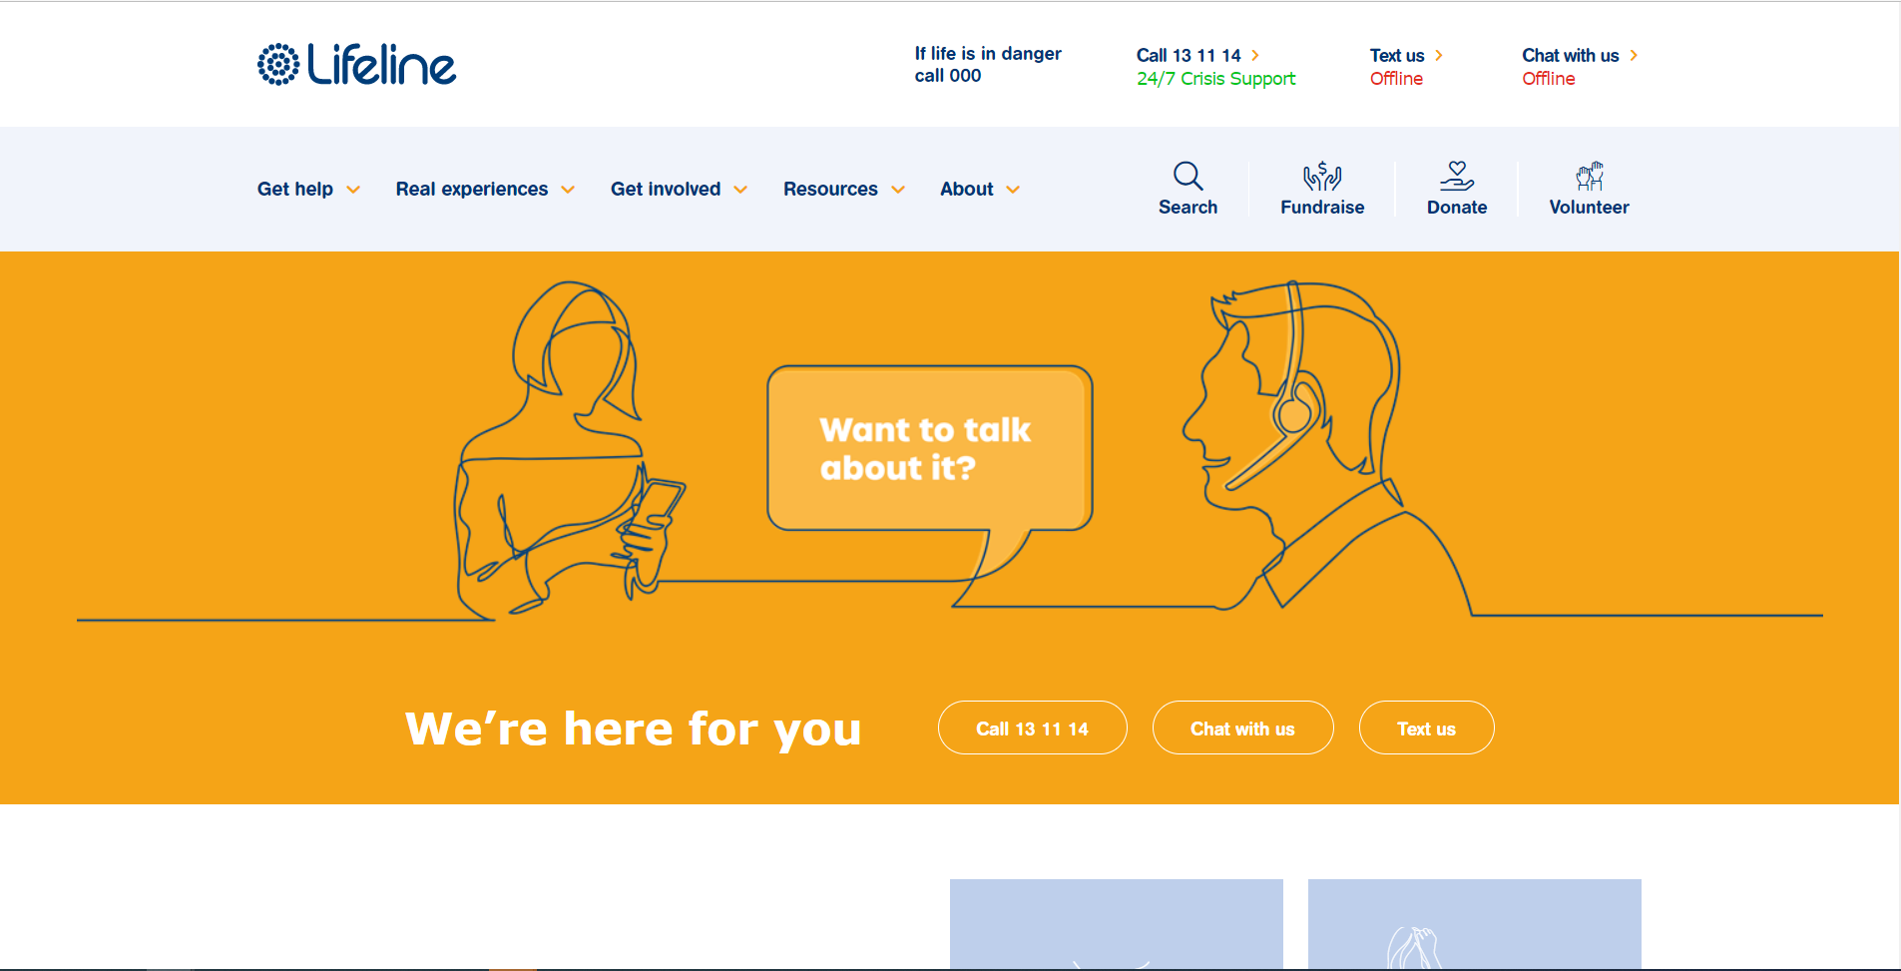
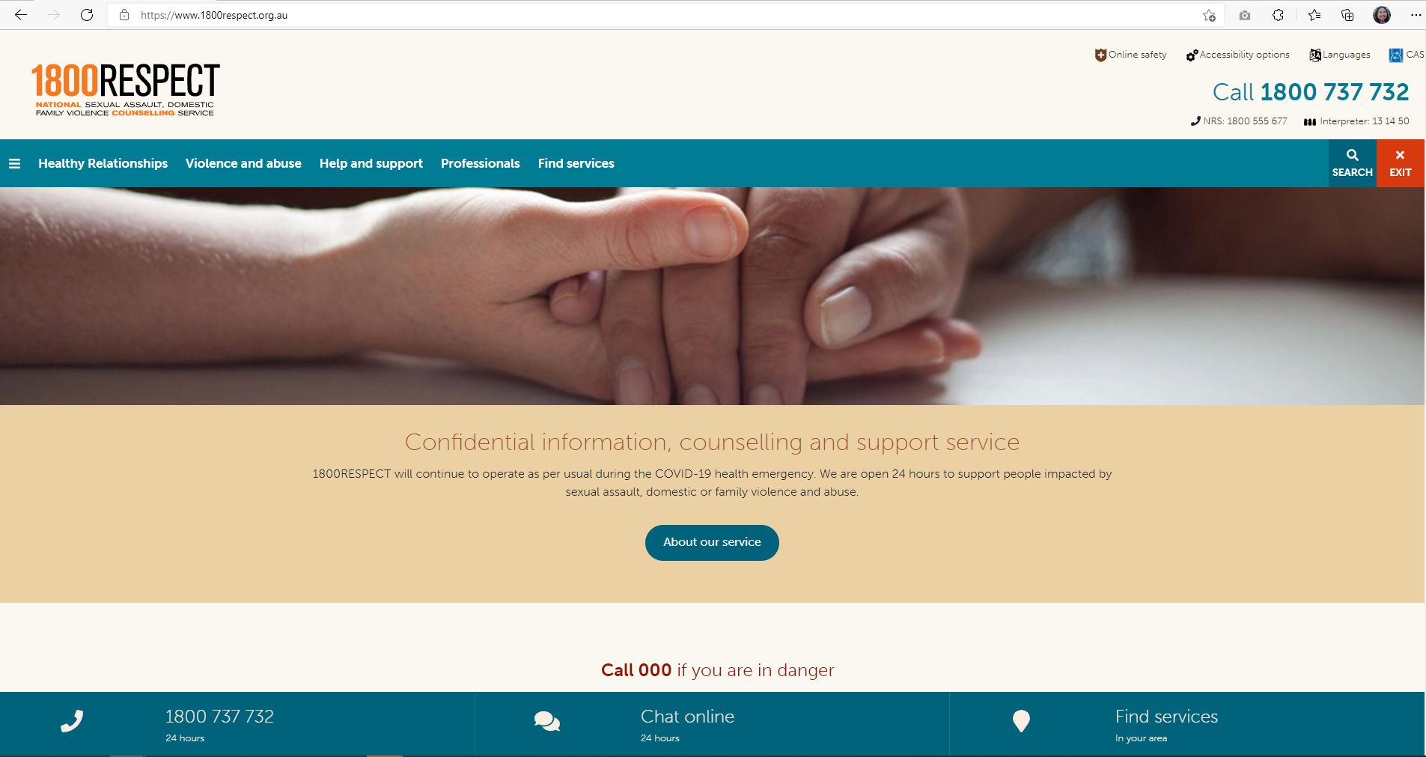
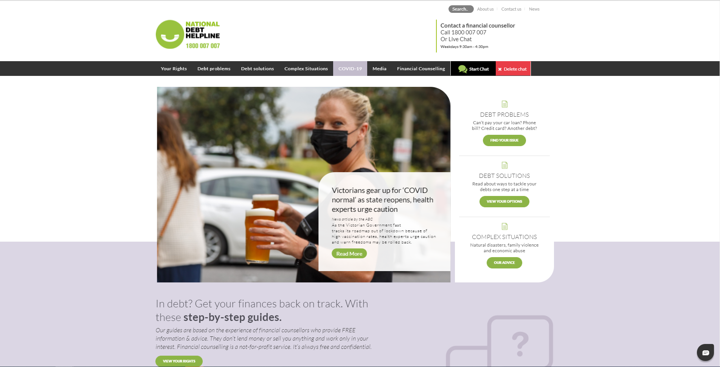
Help Lines
Mental health
Family violence
Debt /Financial Support
LifeLine (13 11 14)
Beyond Blue (1300 224 636)
Sane (1800 187 263)
1800 RESPECT (1800 737 732)
Men’s Line (1300 789 978)
Elder Abuse Helpline (1300 651 192)
National Debt Help Line (1800 007 007)
Interpreter service: 131 450

Slide 8
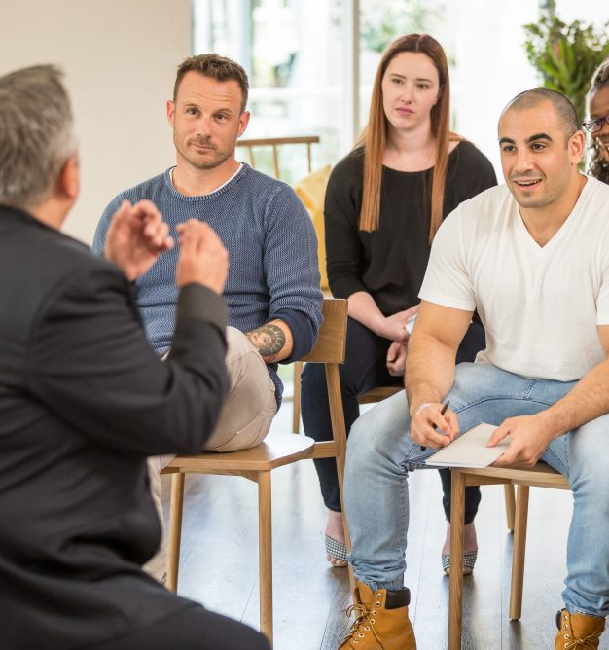
Learning about what works
Community education classes, eg:
Parenting classes
Financial education classes
Support groups, eg:
Gamblers Anonymous
www.gaaustralia.org.au
What Helps

Slide 9
Learning about what works
Websites, eg:
mhfa.com.au
for information about mental health
www.relationships.org.au
for information about relationship matters
www.moneysmart.gov.au
for information about managing money and reducing debt
What Helps

Slide 10
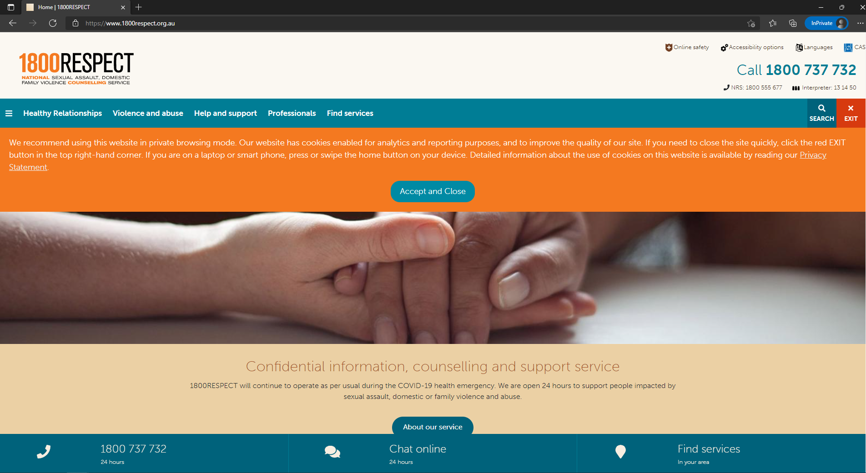
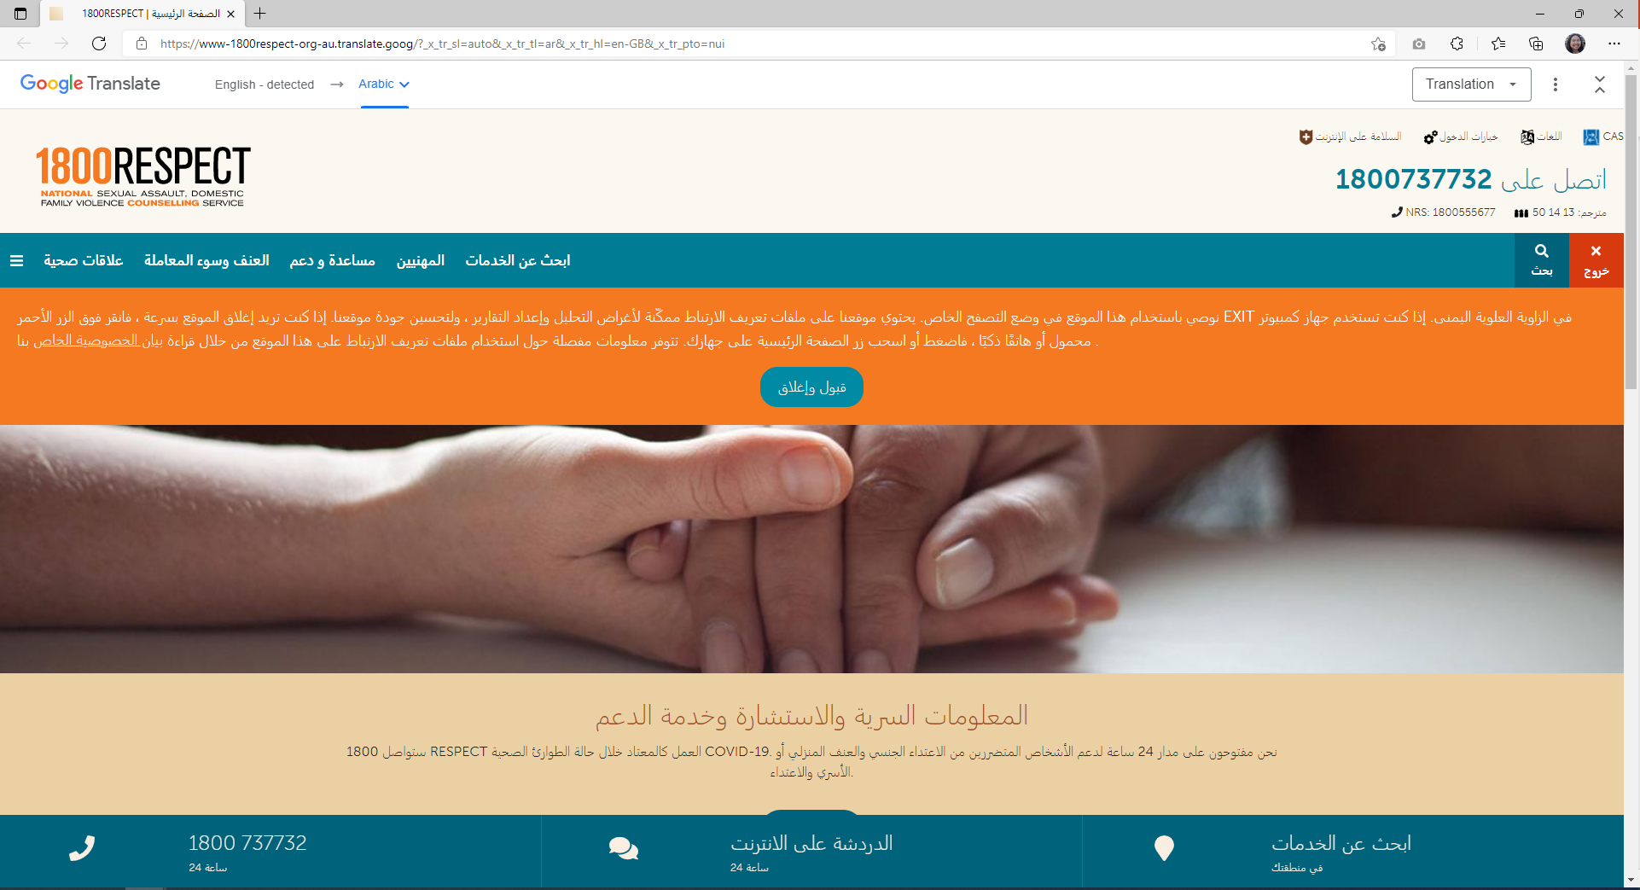
Change the Language

Slide 11
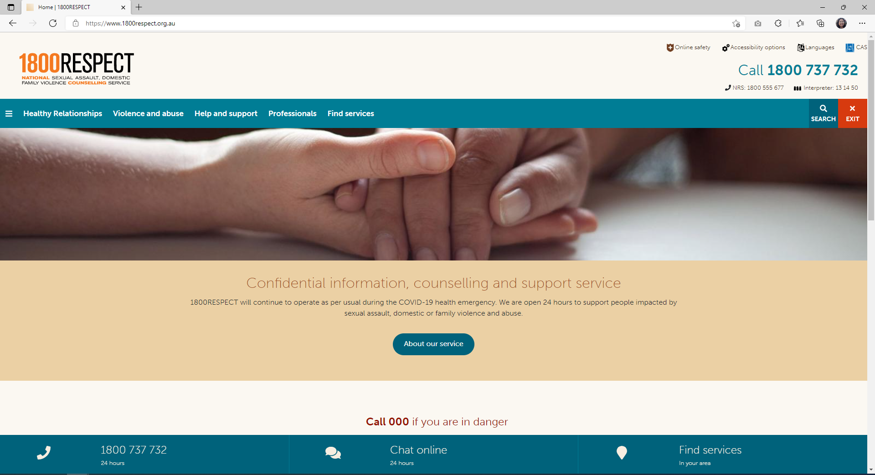
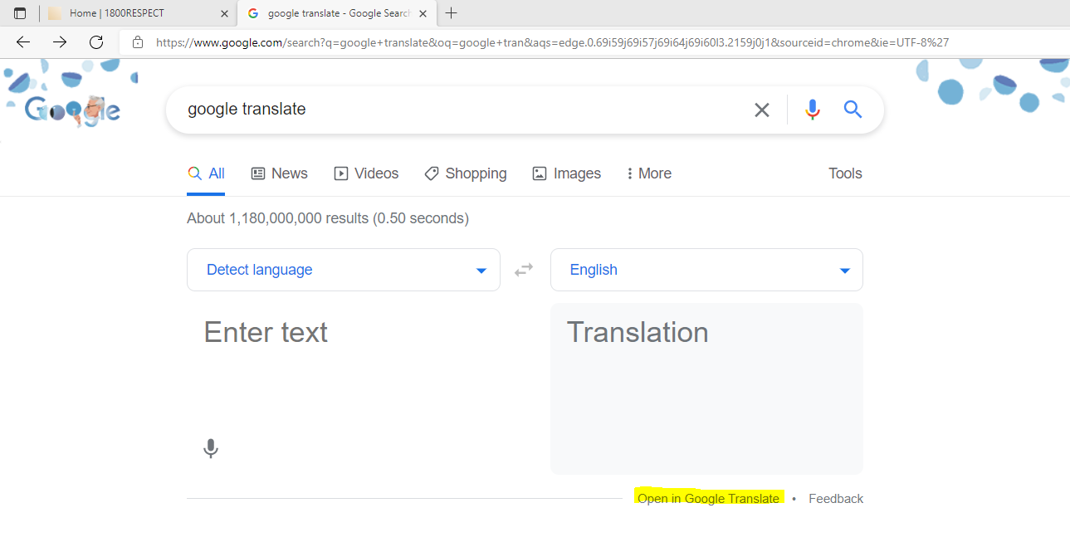
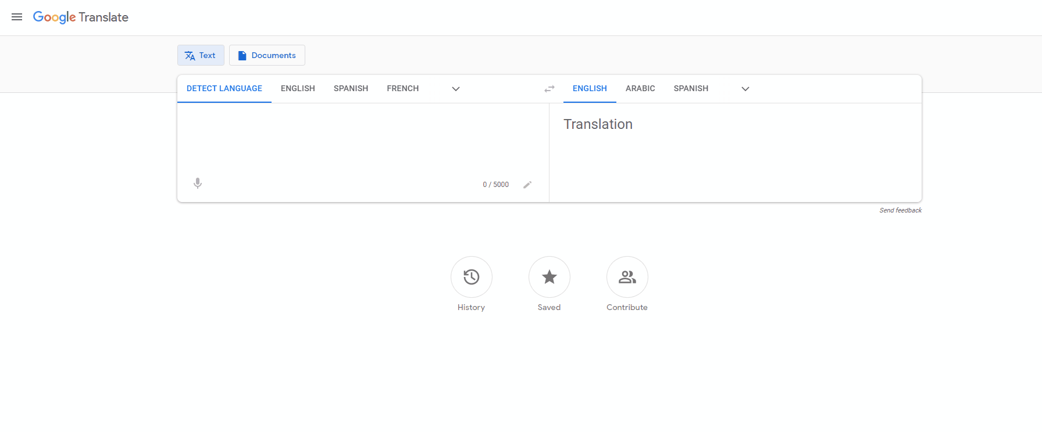
1. Go to website and copy the URL
Converted into your Language
2. Search and open Google Translate
3.Paste the URL of the site
Select your Language

Slide 12
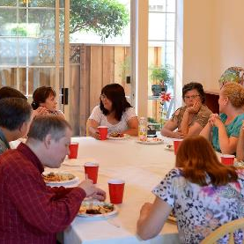
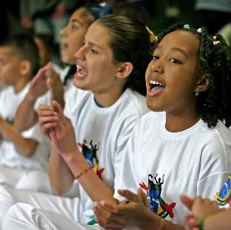
Taking part in the community
Spending time with friends
Joining a club or community centre
Trying a new activity with others
Contributing to community events
What Helps

Slide 13
Looking after yourself
Healthy diet
Limiting drug and alcohol use
Taking time out to do what we want to do
Exercise
Get a health checkup
What Helps

Slide 14
Doctors
Start with contacting a doctor (GP)
Get a Mental Health Plan
(you will pay less money)
Ask for a referral to a counsellor or psychologist
What Helps

Slide 15
WA Connect
waconnect.org.au
Health Direct
healthdirect.gov.au
Ask Izzy
askizzy.org.au
Connect Groups
connectgroups.org.au
Where to find help

Slide 16
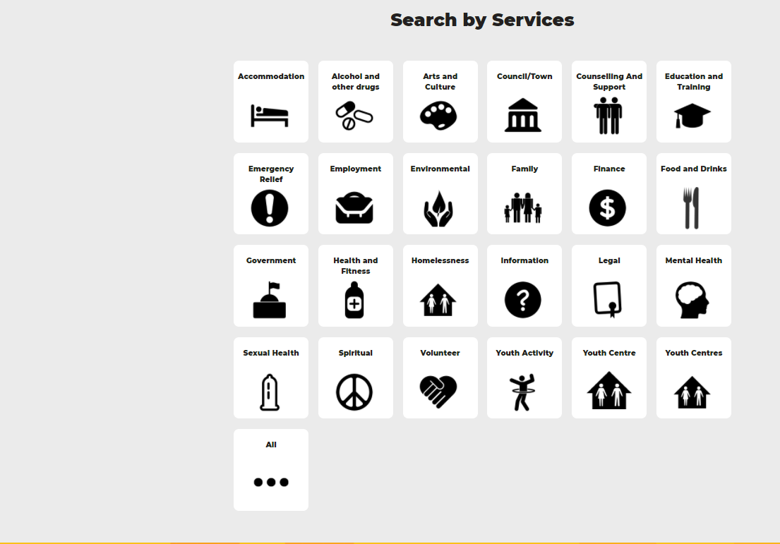
Youth Services Directory
yacwa.org.au/ways/
Where to find help

Slide 17
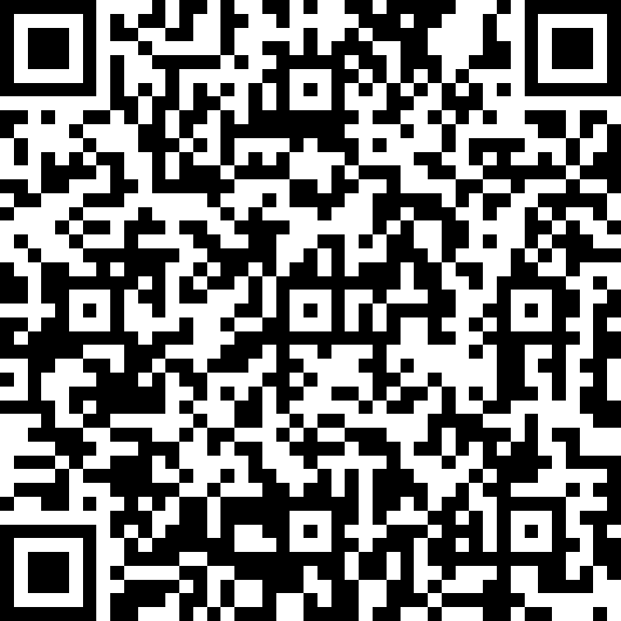
Friend in Need is proudly developed by Anglicare WA.
Let us know what you think!
friendinneedwa
friendinneed
Get in touch:
friendinneed@anglicarewa.org.au
www.friendinneed.org.au

Slide 18
Interested in expanding your knowledge?
Interested in expanding your Knowledge?
Anglicare WA offers a range of educational workshops for different interest groups.​
If you want are interested in a workshop for yourself, your workplace, community group or school then visit our website at www.anglicarewa.org.au to find out more.​
Call us on 1300 11 44 46​ or e-mail: info@anglicarewa.org.au
Relationship Education​
We offer workshops to support you with: Couples relationships, Communication, Family relationships (including parenting support), Emotions and thoughts and Family and domestic violence.
Sessions can be customized to meet your needs. ​
We also work in partnership to deliver Parenting Connection WA with Ngala, Anglicare and Wanslea which provides free locally relevant workshops and information for parents and carers.​
Community Education
School based workshops
“It Only Takes One” empowers students with the knowledge and advocacy skills to be changemakers in their communities.​
Community based workshops “Friend In Need” is a community capacity building workshop targeted at building knowledge and confidence to support people in times of need and understand what services are available and how to connect with them.​
​
Workplace Education ​
We offer a range of workshops aimed at building the skills and knowledge of your employees. ​
Community services – Intro to Family and Domestic Violence, Workshops for enhancing clinical practice,
General workplace development - Accidental Counsellor, Person Centred De-Escalation
White Ribbon accredited Family & Domestic Violence Workplace training​

