Slide 2
Where does it hurt?
If a friend is in pain and we want to help, we first need to know where they are sore.
Sometimes, it’s pretty clear...
…sometimes, it’s not obvious that a friend is hurting.

Slide 3
Where does it hurt when…
We are sad, worried or scared?
We don’t get on with our family, friends, partners or work buddies?
We are worried about money?
Where does it hurt when

Slide 4
What helps?

Slide 5
Talking to people and being listened to
Friend
Family
Neighbour
Teacher
Phone help line
Counsellor:
Psychologist
Relationship counsellor
Financial counsellor
Support group
What Helps

Slide 6
Let’s Talk
Listen
Empathise
Acknowledge
Don’t Judge
I noticed you haven’t been yourself lately. Is everything OK?

Slide 7
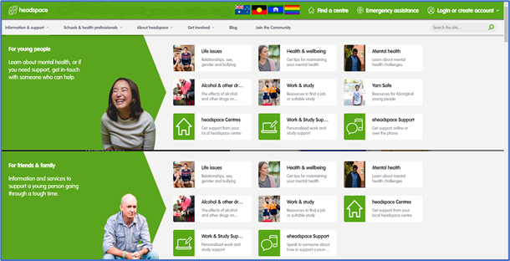
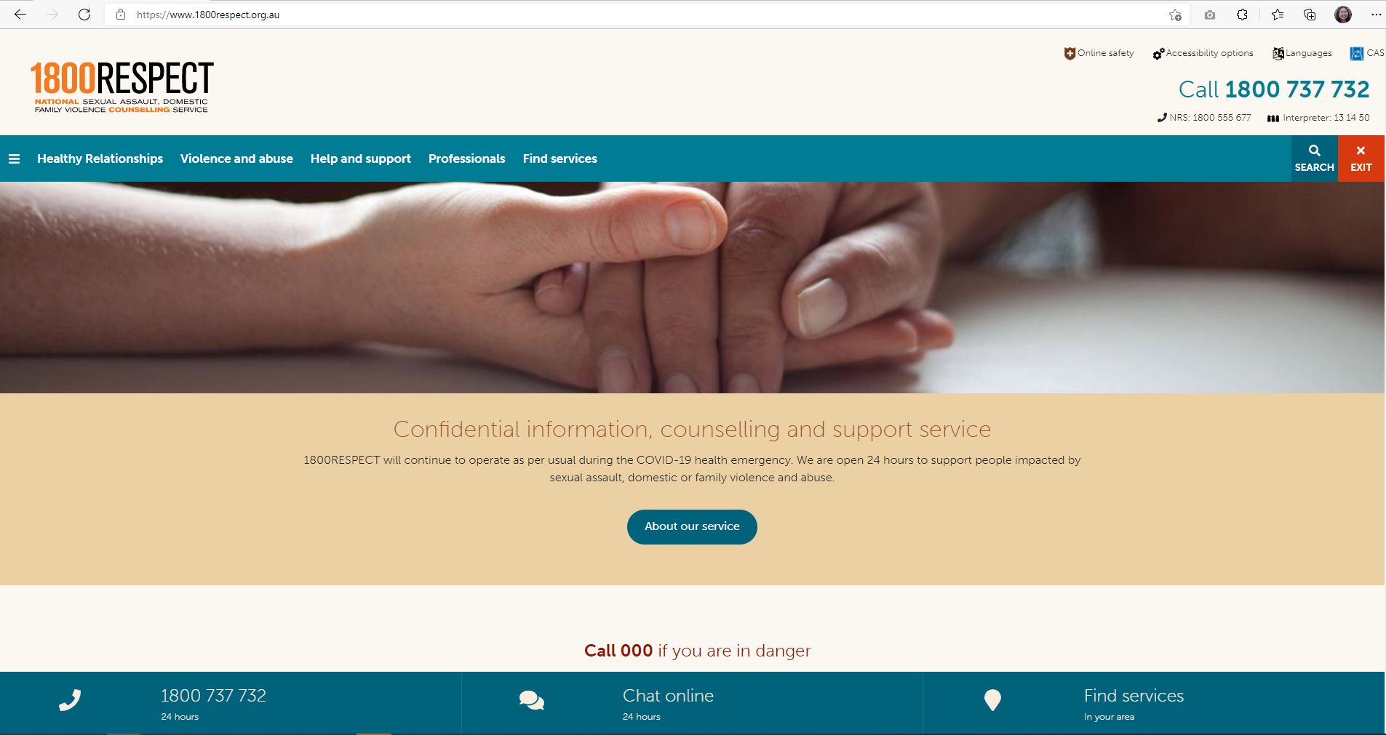
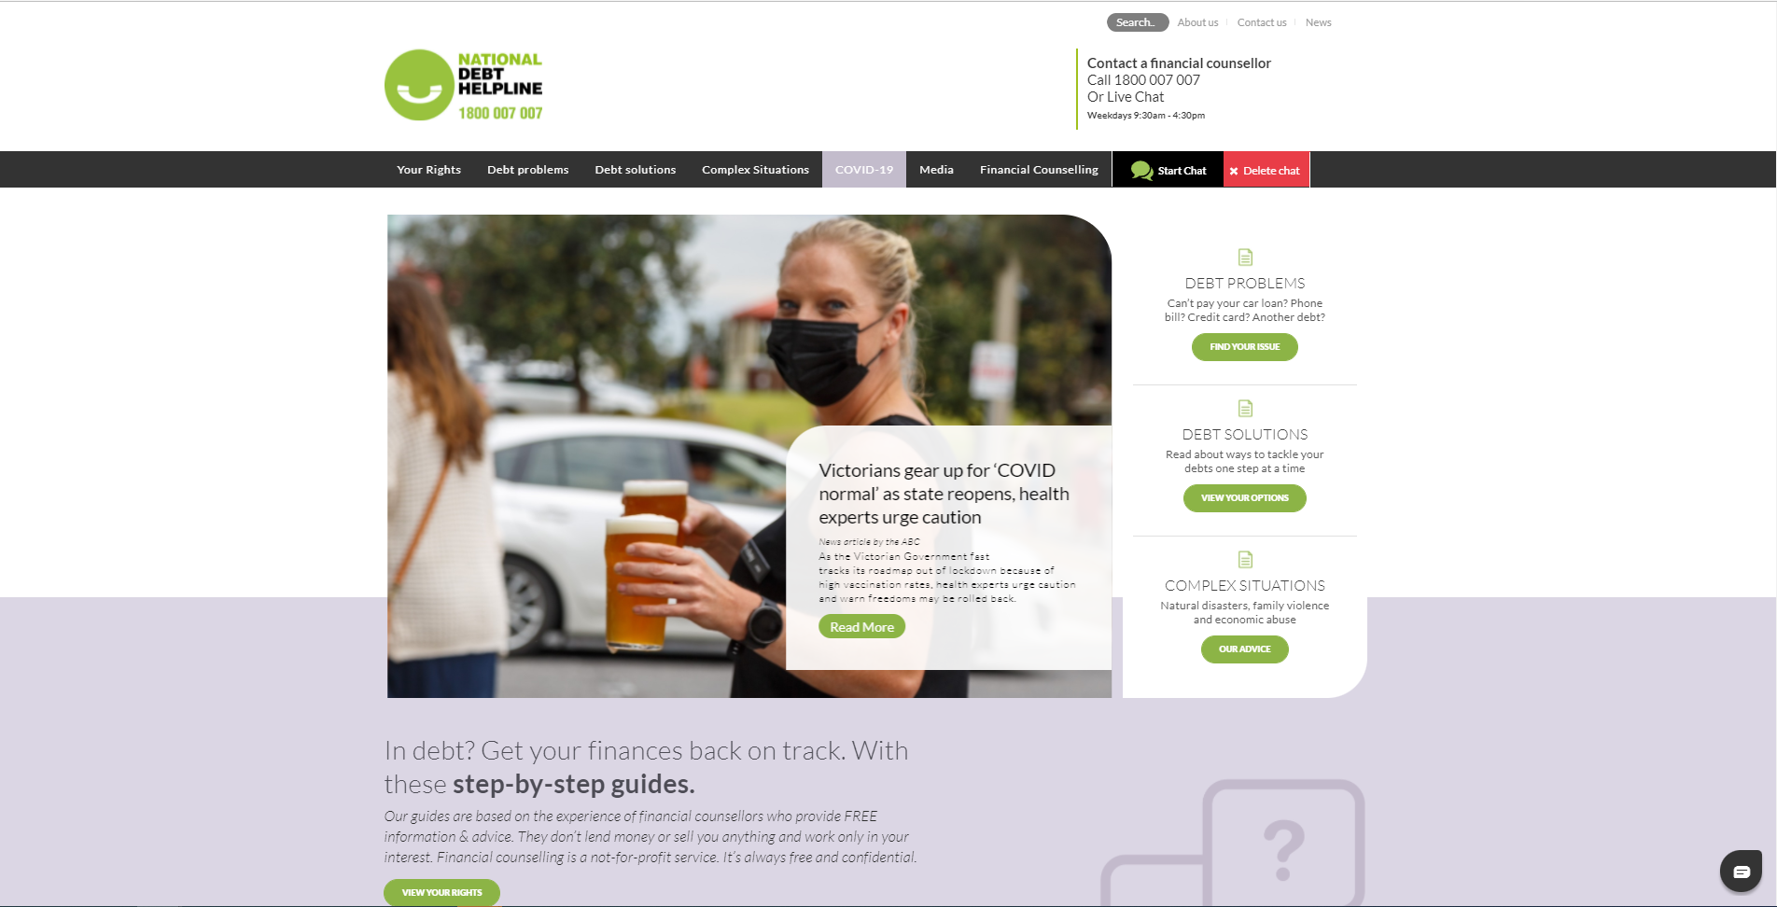
Help Lines
Mental health
Family violence
Debt /Financial Support
LifeLine (13 11 14)
Headspace
Kids Helpline (1800 55 1800)
1800 RESPECT (1800 737 732)
Men’s Line (1300 789 978)
National Debt Help Line (1800 007 007)
What Helps

Slide 8
Taking part in the community
Spending time with friends
Joining a club or community centre
Trying a new activity with others
Contributing to community events
What Helps

Slide 9
Looking after yourself
Healthy diet
Limiting drug and alcohol use
Taking time out to do what we want to do (hobbies, spiritual matters)
Exercise
Get a health checkup
What Helps

Slide 10
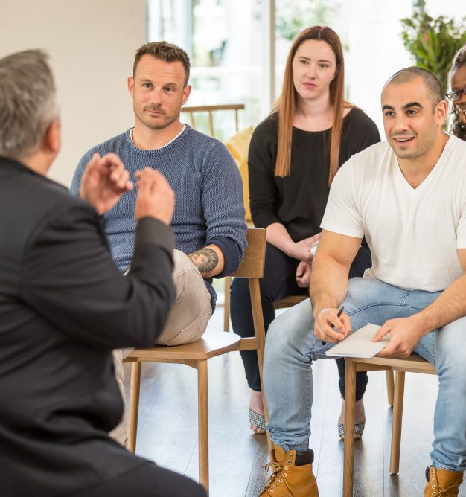
Learning about what works
Help lines, eg:
SANE (1800 18 7263)
Support groups and organisations, eg:
Freedom Centre, LGBTIQ support www.freedom.org.au
What Helps
What Helps

Slide 11
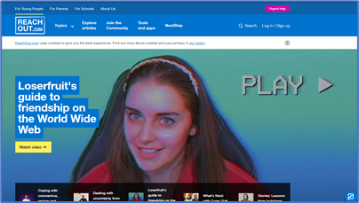
Learning about what works
Websites, eg:
au.reachout.com for information about mental health
headspace.org.au for information about life matters, relationships
moneysmart.gov.au for information about managing money and reducing debt
What Helps

Slide 12
Professional Helpers
Start with contacting a help line or a GP (make sure you have a Medicare card)
Ask for a ‘Mental Health Plan’
Ask for a referral to a counsellor or psychologist
‘Shop around’
What Helps

Slide 13
Confidentiality
Under 16:
Mandatory reporting when there are concerns for safety
Age 16-17:
Some discretion about whether to inform parents, police, police or Dept of Communities
Age 18+:
Automatic confidentiality (although most things you say to a doctor or counsellor remain private before then, too)
https://au.reachout.com/articles/how-age-affects-confidentiality

Slide 14
Where to find help

Slide 15
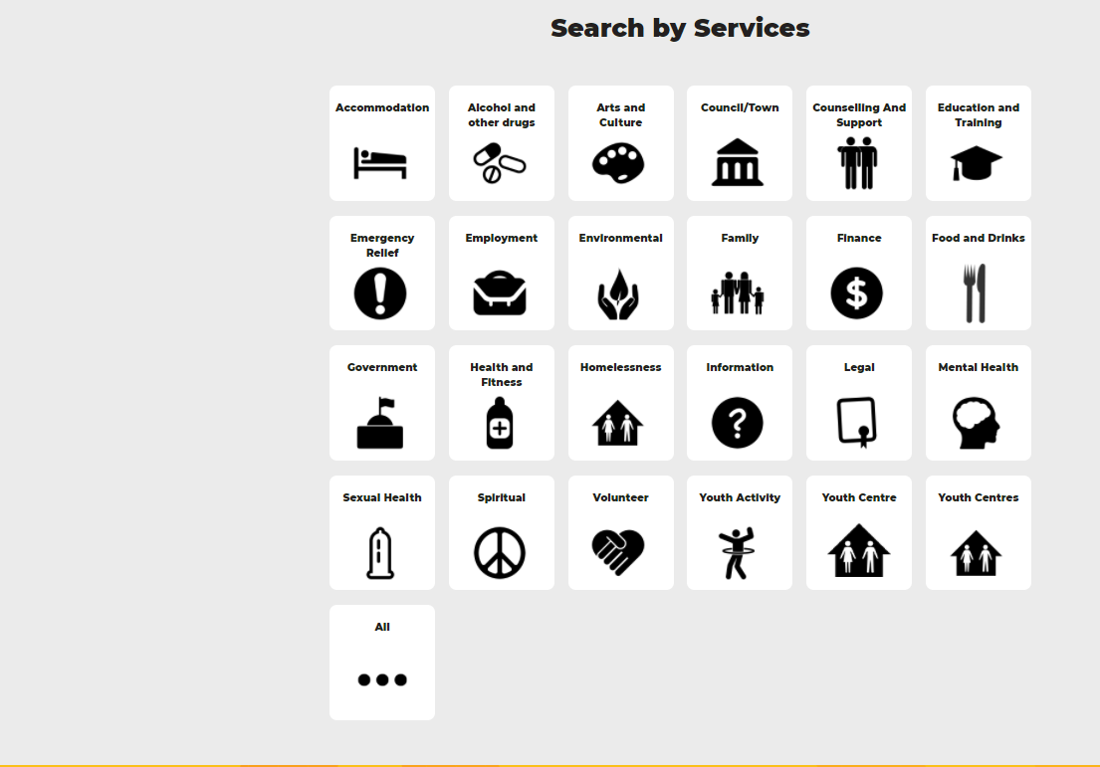
Youth Services Directory
yacwa.org.au/ways/
Where to find help

Slide 16
WA Connect
waconnect.org.au
Health Direct
healthdirect.gov.au
Ask Izzy
askizzy.org.au
Connect Groups
connectgroups.org.au
Where to find help

Slide 17
What are you going to do next?
Is there anyone you can reach out to already?
What can you do to help someone ‘belong’?
How can you help the community?

